Slide 1
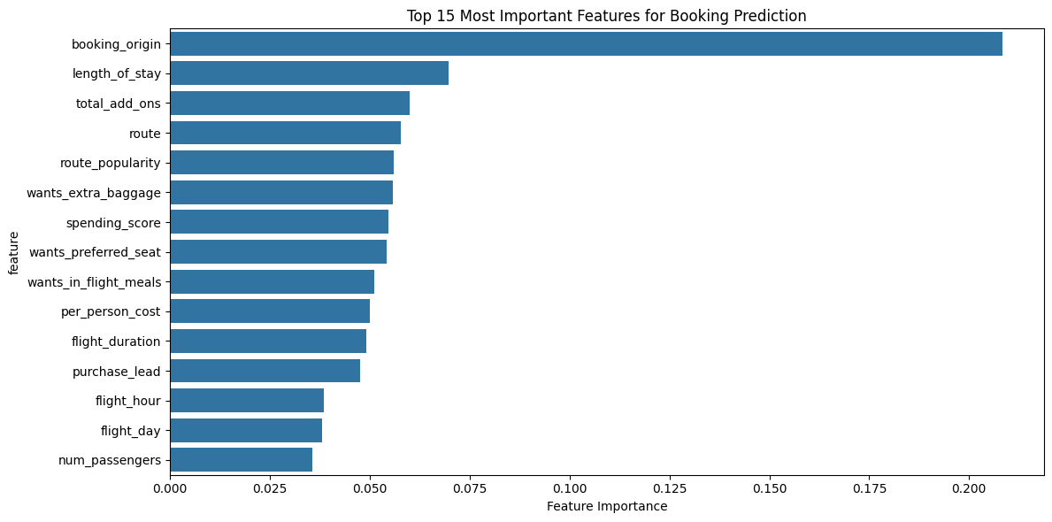
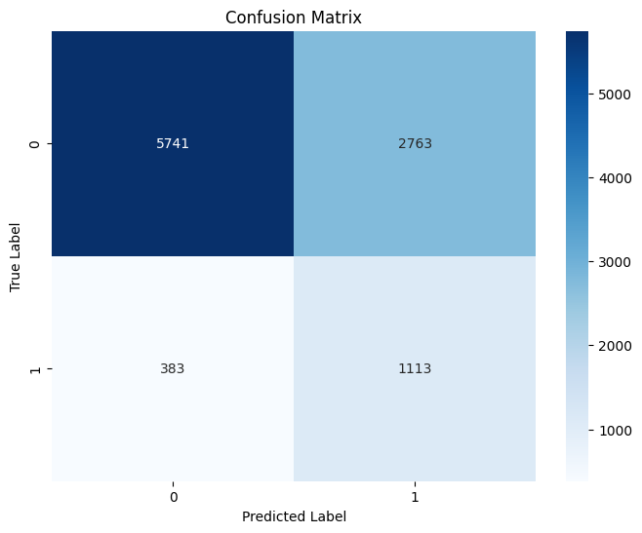
British Airways Holiday Purchase Prediction Analysis
Accuracy: 69%
ROC AUC: 0.77
Cross-Val ROC AUC: 0.77 (±0.005)
Confusion Matrix Insights:
True Negatives (5741): Correctly predicted non-buyers
False Positives (2763): Incorrectly flagged as buyers
False Negatives (383): Missed potential buyers
True Positives (1113): Correctly identified buyers
Key Findings
Booking origin is the strongest predictor, accounting for ~21% of model decisions
Length of stay and total add-ons are the next most important features
Model shows good discrimination ability (AUC: 0.77) but has room for improvement
High false positive rate suggests opportunity to refine targeting criteria
Travel-related features (route, popularity) and customer preferences (baggage, meals) show moderate importance

